Slide 1
3- Python Interpreter

Slide 2
context
Python interpreter 3
What is an Expression? 4
Code in shell:
Ex.1 5
Ex.2 – get Boolean value 6
What is SyntaxError? 7
Ex.3 8

Slide 3
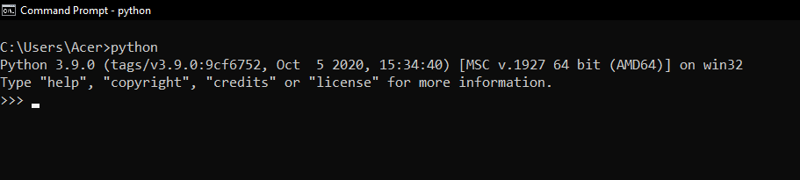
Python interpreter
What you see here is python interpreter
Basicly is a program that execute code
We can type our python code:
In a file and give it to this interpreter
directly here in this interactive shell

Slide 4
What is an Expression?
a piece of code that produces a value

Slide 5
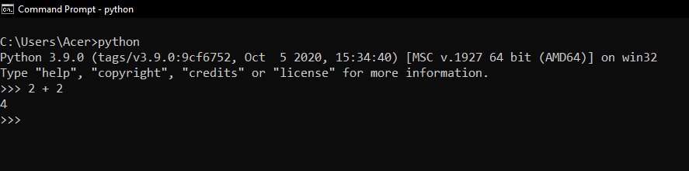
Ex.1

Slide 6
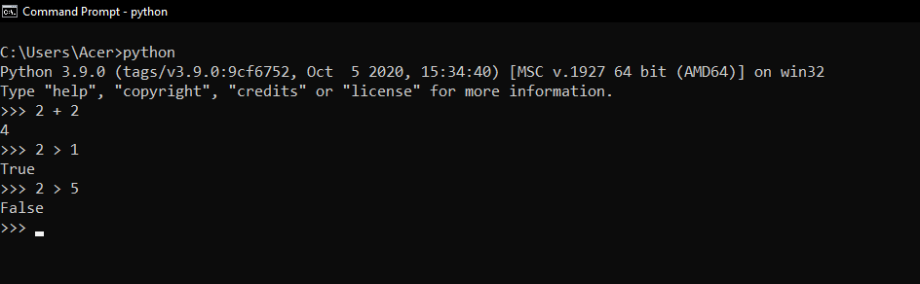
Ex.2 – get Boolean value

Slide 7
What is SyntaxError?
in programming syntax means grammar

Slide 8
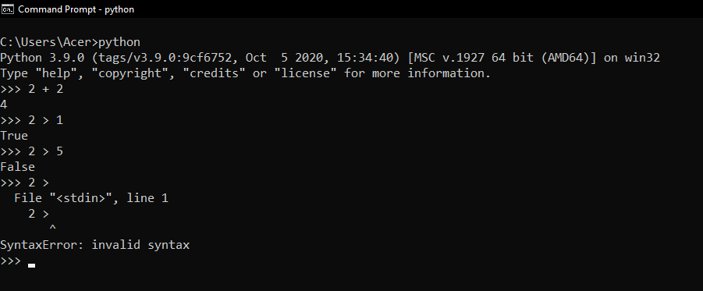
Ex.3

